Slide 1
Automatic Annotation of Actigraphy Data for Sleep Disorders Diagnosis Purposes
Alexandre Domingues¹, Ondrej Adamec^{1,2}, Teresa Paiva³ and J. Miguel Sanches¹
¹ Institute for Systems and Robotics, Instituto Superior Técnico, Lisbon, Portugal
² Faculty of Electrical Engineering and Computer Science, VSB – TU Ostrava, Czech Republic
³Faculdade de Medicina da Universidade de Lisboa, Lisbon, Portugal

Slide 2
Structure
Motivation
Actigraphy
Data sets
Data classification
Results
Conclusions

Slide 3
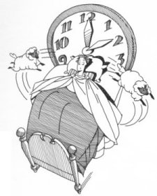
Motivation
Sleep disorders
Affect a significative percentage of young and adult population.
Can be related with diabetes, obesity, depression and cardiovascular diseases.
Diagnosis involves complex and intrusive procedures.
Many individuals never seek medical care.

Slide 4
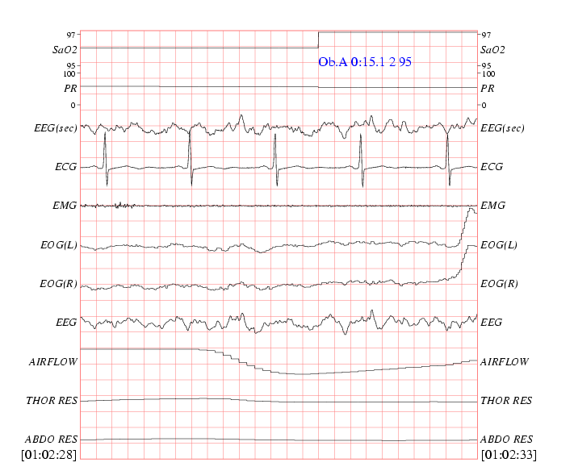
Motivation
Diagnosis
Standard procedure:
Polysomnography
Several physiological signals are acquired (EEG, EOG, EMG, Oxymetry,etc…)
Data is acquired in a controled and reliable environment

Slide 5
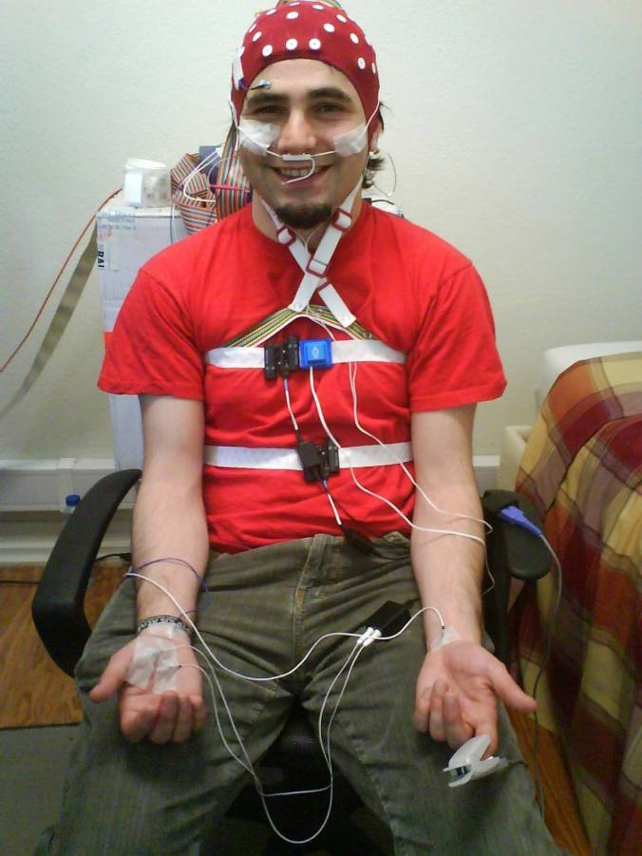
Motivation
Diagnosis
PSG - Difficulties
Performed in medical facilities
The exam is highly intrusive.
Long term monitoring is not feasible
Data processing is done offline and is a time consuming process.
Faster, low cost and Portable methods are needed!

Slide 6
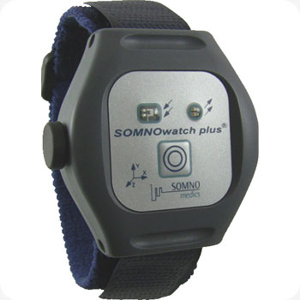
Actigraphy
Non invasive and portable sensor.
Low cost solution to gather valuable information
Allows for long term monitoring.
Automatic determination of the
Sleep / Wakefulness state

Slide 7
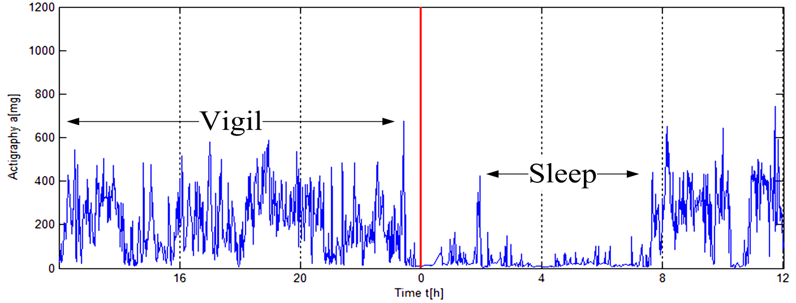
Data sets
Collected from 23 healthy subjects for a period of 14 days.
Segmented by trained technicians with the help of light information and a sleep diary.
Data segments grouped into two large sleep and wakefulness arrays.

Slide 8
Statistical properties extraction
Two large arrays of Sleep/Wakefulness data
α¹₁ … … … … … α¹_{p}
α²₁ … … … … … α²_{p}
Time
α³₁ … … … … … α³_{p}
‘W’
overlapping windows
α^{w}₁ … … … … … α^{w}_{p}
‘p’ order autoregressive model (α = parameters)

Slide 9
Bayes classifier
Clouds of parameters of each class described by a Gaussian distribution
New set of data
Classification into wakefulness or sleep state
Each class (w_{s} , w_{w}) described by a pair of features:
Bayes classifier

Slide 10
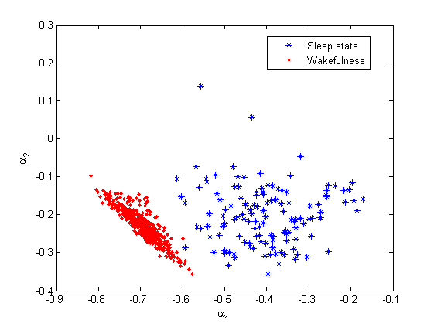
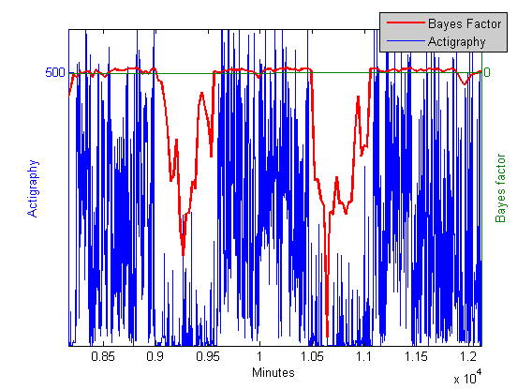
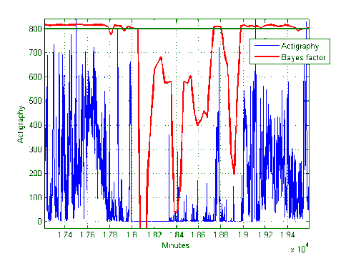
Results
Performance of the estimator
Leave-one-out Cross-validation:
Accuracy ≈ 96%
Sensitivity ≈ 98%
Specificity ≈ 74%

Slide 11
Results
Distribution of the coefficients obtained with a 2nd order autoregressive model

Slide 12
Results
Bayes factor for 2 days/nights

Slide 13
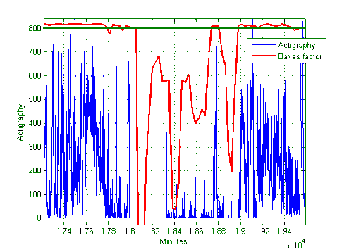
Results
Detection of a wakening episode

Slide 14
Conclusions
Classification procedure with real actigraphy data. Based on autoregressive (AR) models
Bayes classifier with 96% accuracy.
Future work
More physiological data, e.g., light, position, oximetry, and temperature.
Step toward an alternative method in the diagnosis of some sleep disorders involving long term monitoring – Light Polysonmography (LPSG)

Slide 15
32nd Annual International Conference of the IEEE Engineering in Medicine and Biology Society
Thank You

